Slide 1



Web Development Session 1
Introduction and Basic HTML
Taught by the CST Web Development Team

Slide 2

Up for Today
Motivation
Steps to Build a Website
Web Programming Languages
How the Internet Works
Coding Setup
Basic HTML

Slide 3

Motivation
One of the most crucial areas of computer science
Internet has over 5B users and there are over 1B websites
Always needed by businesses
Most common CS job/freelance/intern in Egypt and pays well
Remote is also often very possible
Knowledge will be assumed in at least the database and software engineering courses
Makes you self-sufficient in the business world
EXCITED?

Slide 4
Guidelines
This is much easier than C++
This is an official training
Attendance is a proof you participated in the training
In-session tasks, weekly projects and final project are all graded
Exceptional students do deserve small gifts
Never hesitate to ask questions
Your feedback is always welcome and valued

Slide 5
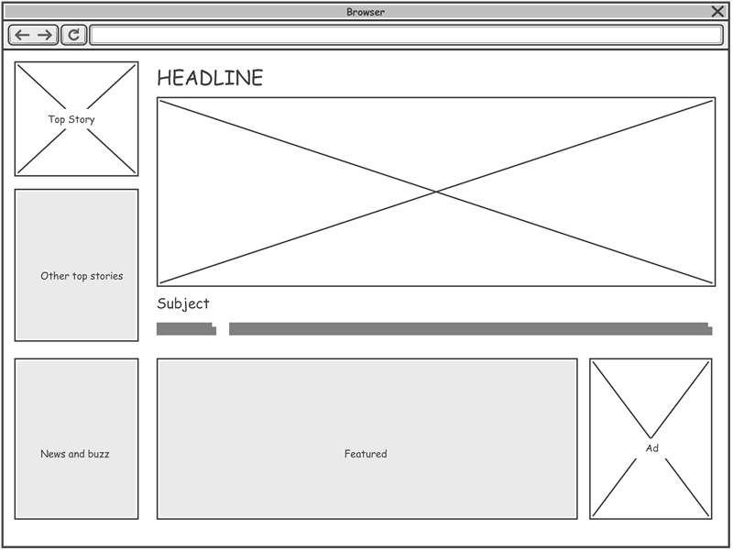
Building a Website
Step 1: Design the UX for the website

Slide 6

Building a Website
Step 1: Design the UX for the website
Step 2: Design the UI for the website

Slide 7

Building a Website
Step 1: Design the UX for the website
Step 2: Design the UI for the website
Step 3: Front-end Development

Slide 8

Building a Website
Step 1: Design the UX for the website
Step 2: Design the UI for the website
Step 3: Front-end Development
Step 3: API + Back-end Development

Slide 9

Building a Website
Step 1: Design the UX for the website
Step 2: Design the UI for the website
Step 3: Front-end Development
Step 3: API + Back-end Development
Step 4: Integrate backend and front-end

Slide 10

Building a Website
Step 1: Design the UX for the website
Step 2: Design the UI for the website
Step 3: Front-end Development
Step 3: API + Back-end Development
Step 4: Integrate backend and front-end
Step 5: Test

Slide 11

Building a Website
Step 1: Design the UX for the website
Step 2: Design the UI for the website
Step 3: Front-end Development
Step 3: API + Back-end Development
Step 4: Integrate backend and front-end
Step 5: Test
Step 6: Deploy

Slide 12
Building a Website
Go www.MyWebsite.com

Slide 13
Building a Website: Roles
Role | Purpose | Tool | Note
UX Designer | How the website behaves (User Experience) | Software (e.g., WireFrames) or Sketch | Possibly the client (zero coding)
UI Designer | How the website looks (User Interface) | Most likely software (e.g., Figma) or sketch | (zero coding)
Front-end Developer | Write code equivalent to the design + routing | Code Editor | HTML, CSS, JavaScript + Many Novelties
Browsers Understand HTML, CSS, JavaScript and thus Render the Design Next Step is to Attach Application Logic to the Front-end
Back-end Developer | Writes code for the website logic and data operations | Code Editor | JavaScript, Python, Ruby, C++, etc.
Tester | Test the Website | Code Editor (Test Scripts) | E.g., Selenium
DevOps Engineer | Deploy the Website | Code Editor/Services | E.g., Amazon AWS

Slide 14


BRAIN TEASER
A man is looking at a photograph of someone.
His friend asks who it is.
The man replies, “Brothers and sisters, I have none.”
He continues “But that man’s father is my father’s son.”
Who was in the photograph?

Slide 15
Web Programming Languages
The most basic website is pure HTML
HTML is responsible for the content of the website and how its grouped

Slide 16
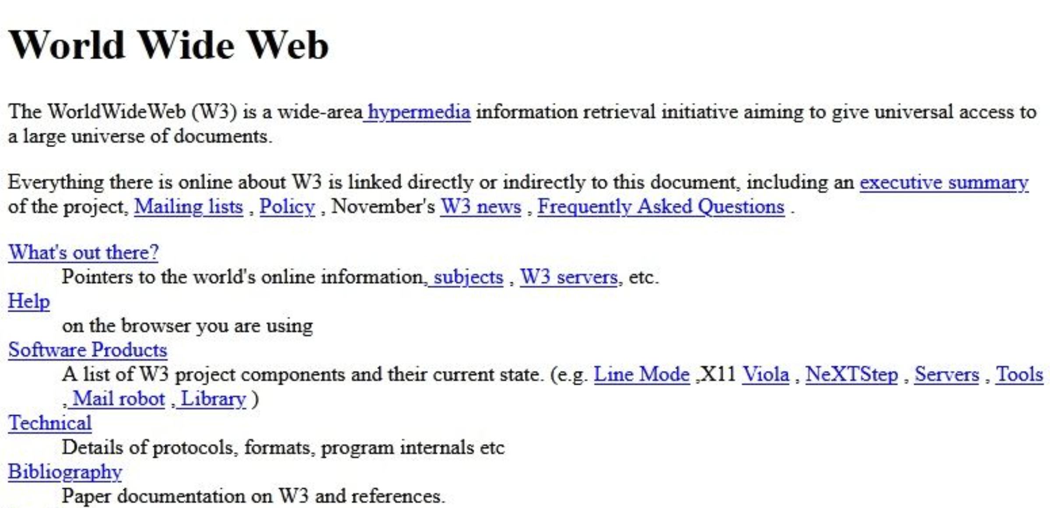
Web Programming Languages
The most basic website is pure HTML
HTML is responsible for the structure of the website

Slide 17
Web Programming Languages
The most basic website is pure HTML
HTML is responsible for the structure of the website
You can reference parts of the HTML with CSS to give them a unique style
CSS is responsible for the look of the website
Front-end engineering must be fluent in HTML and CSS

Slide 18
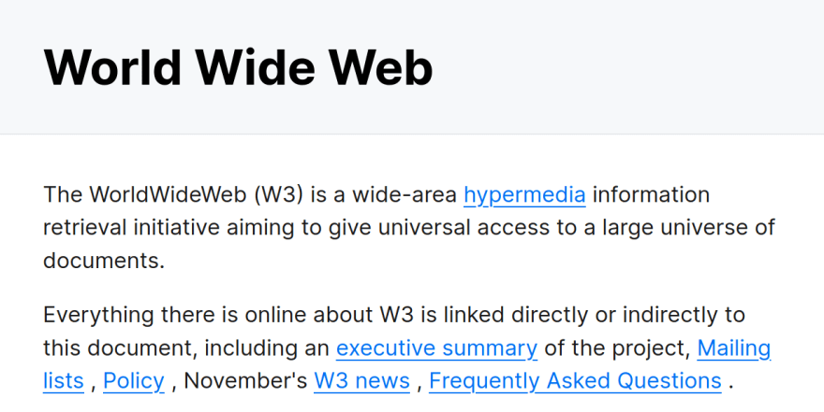
Web Programming Languages
You can reference parts of the HTML with CSS to give them a unique style
CSS is responsible for the look of the website

Slide 19
Web Programming Languages
The most basic website is pure HTML
HTML is responsible for the structure of the website
You can reference parts of the HTML with CSS to give them a unique style
CSS is responsible for the look of the website
We can associate JavaScript to an HTML file (e.g., page) to manipulate HTML and CSS in response to events that occur in the page to add interactivity (basic logic).

Slide 20
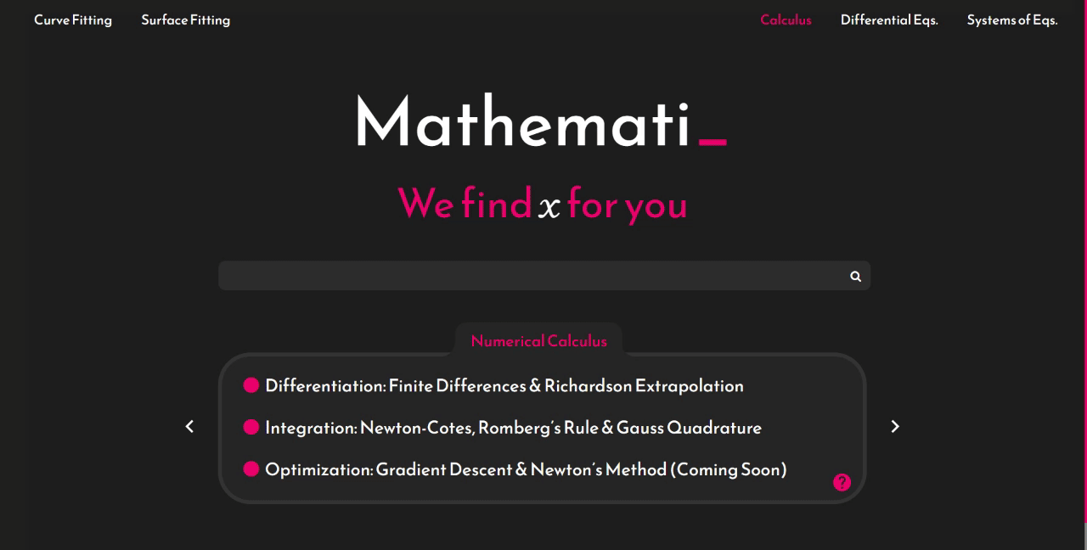
Web Programming Languages
We can associate JavaScript to an HTML file (e.g., page) to manipulate HTML and CSS in response to events that occur in the page to add interactivity (basic logic).

Slide 21

Web Programming Languages
A pure front-end website would use HTML, CSS and JavaScript only
For example, portfolio websites

Slide 22
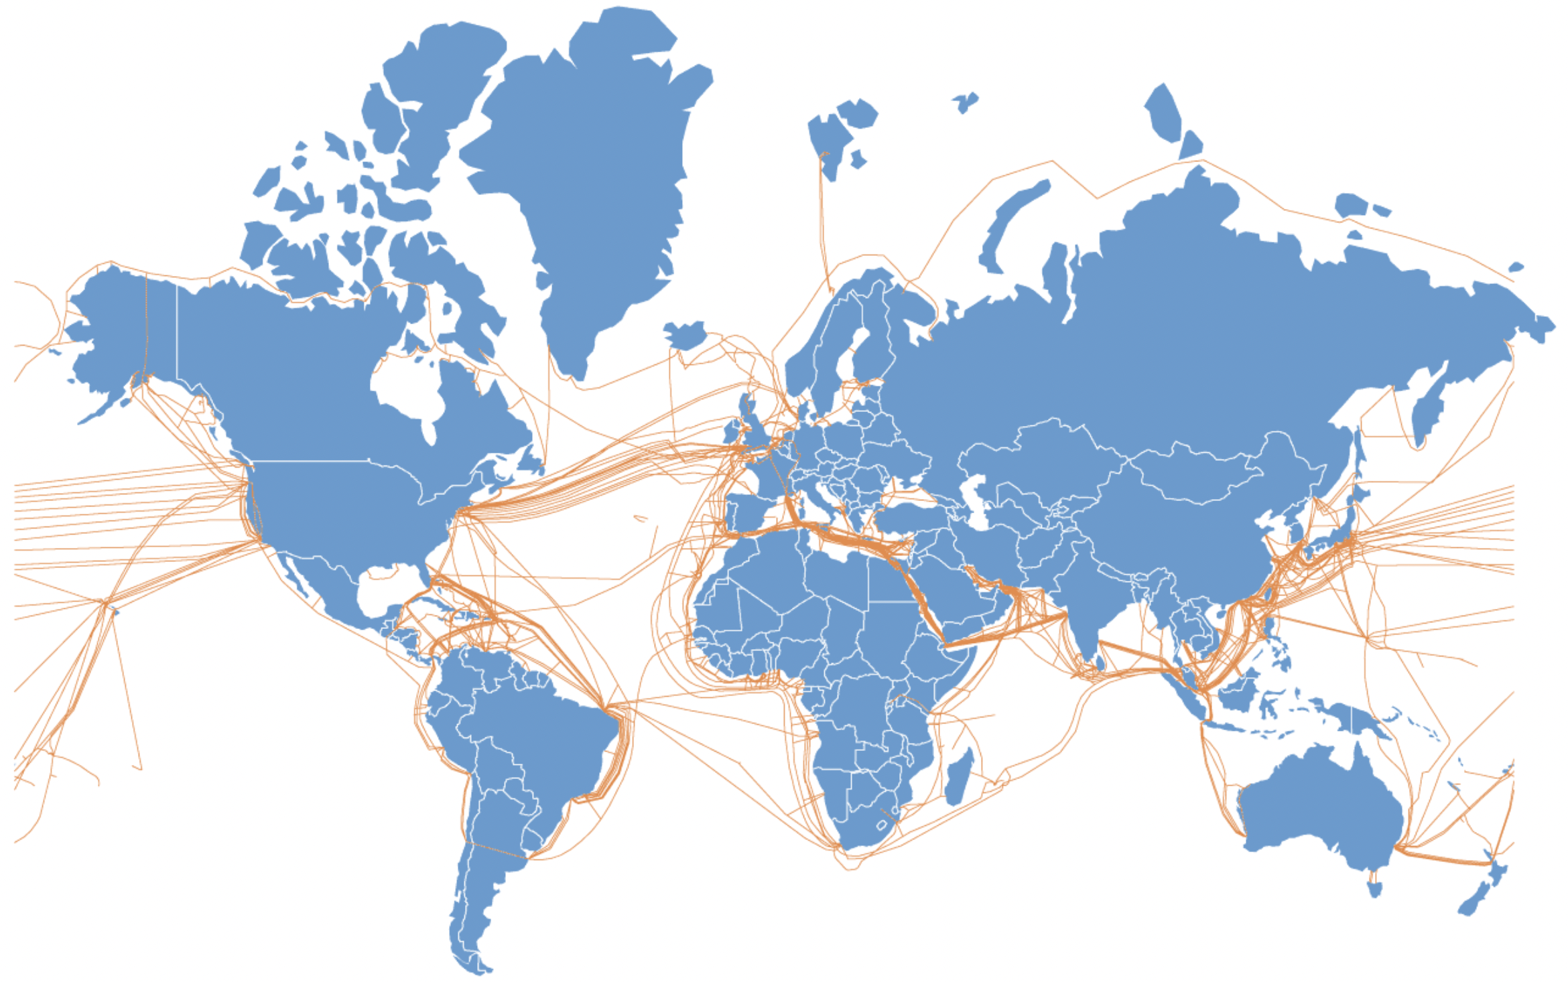
How the Internet Works
The internet protocol consists of machines connected to routers, each belonging to an ISP and ISPs are connected together (over 90% is wired)
Any computer in this network has an IP address and can reach (send data to) any other computer by its IP address

Slide 23
How the Internet Works
A pure-frontend website is much like a word document
You first design it on your machine then deploy it to the internet
Deploying to the internet is equivalent to putting the “document” on a machine (i.e., server)
That machine is responsible for responding with the website content whenever a client request it by visiting it www.MyWebsite.com
Someone visits www.MyWebsite.com from their computer
The ISP of their computer knows the IP address of the machine hosting www.MyWebsite.com
Their computer sends a message requesting the website content from the machine
Machine responds with the content (HTML, CSS and JavaScript)
Browser understands HTML, CSS and JavaScript and renders the content

Slide 24
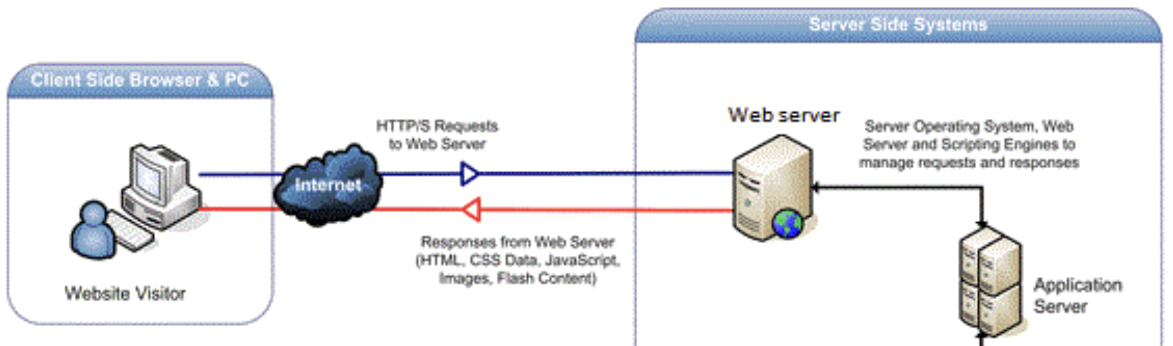
Web Programming Languages
More generally, website may be associated with a backend for application logic
JavaScript can be used for application logic but it is not a good idea.
Instead of executing logic, invoke a server that does (many languages are possible)

Slide 25
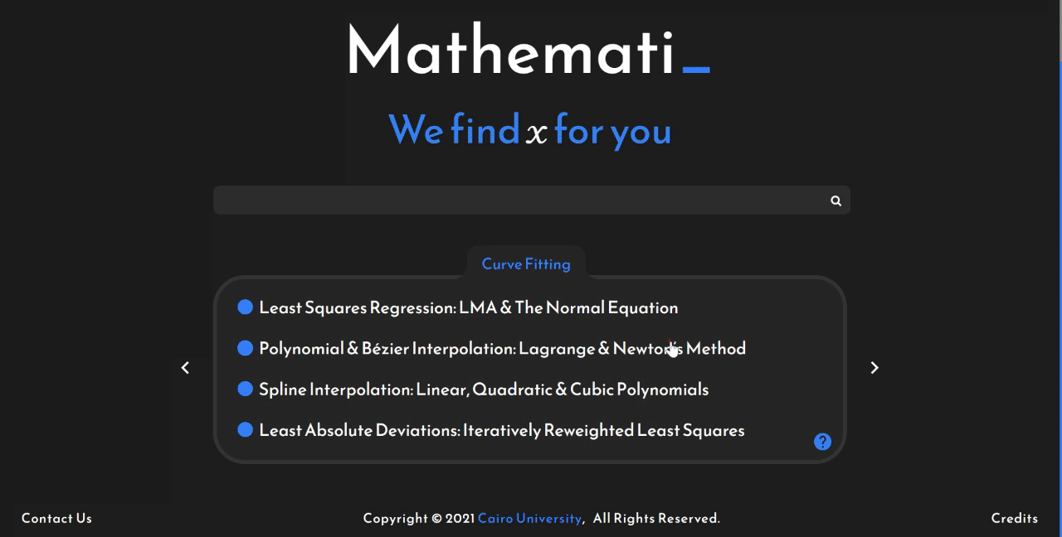
Web Programming Languages

Slide 26
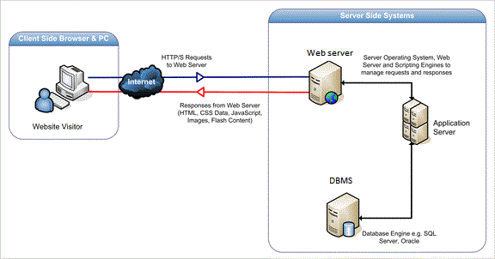
Web Programming Languages
In the most general form, also associated with a database (dynamic website)
For instance, application logic can be to insert a new user into a database upon sign up

Slide 27
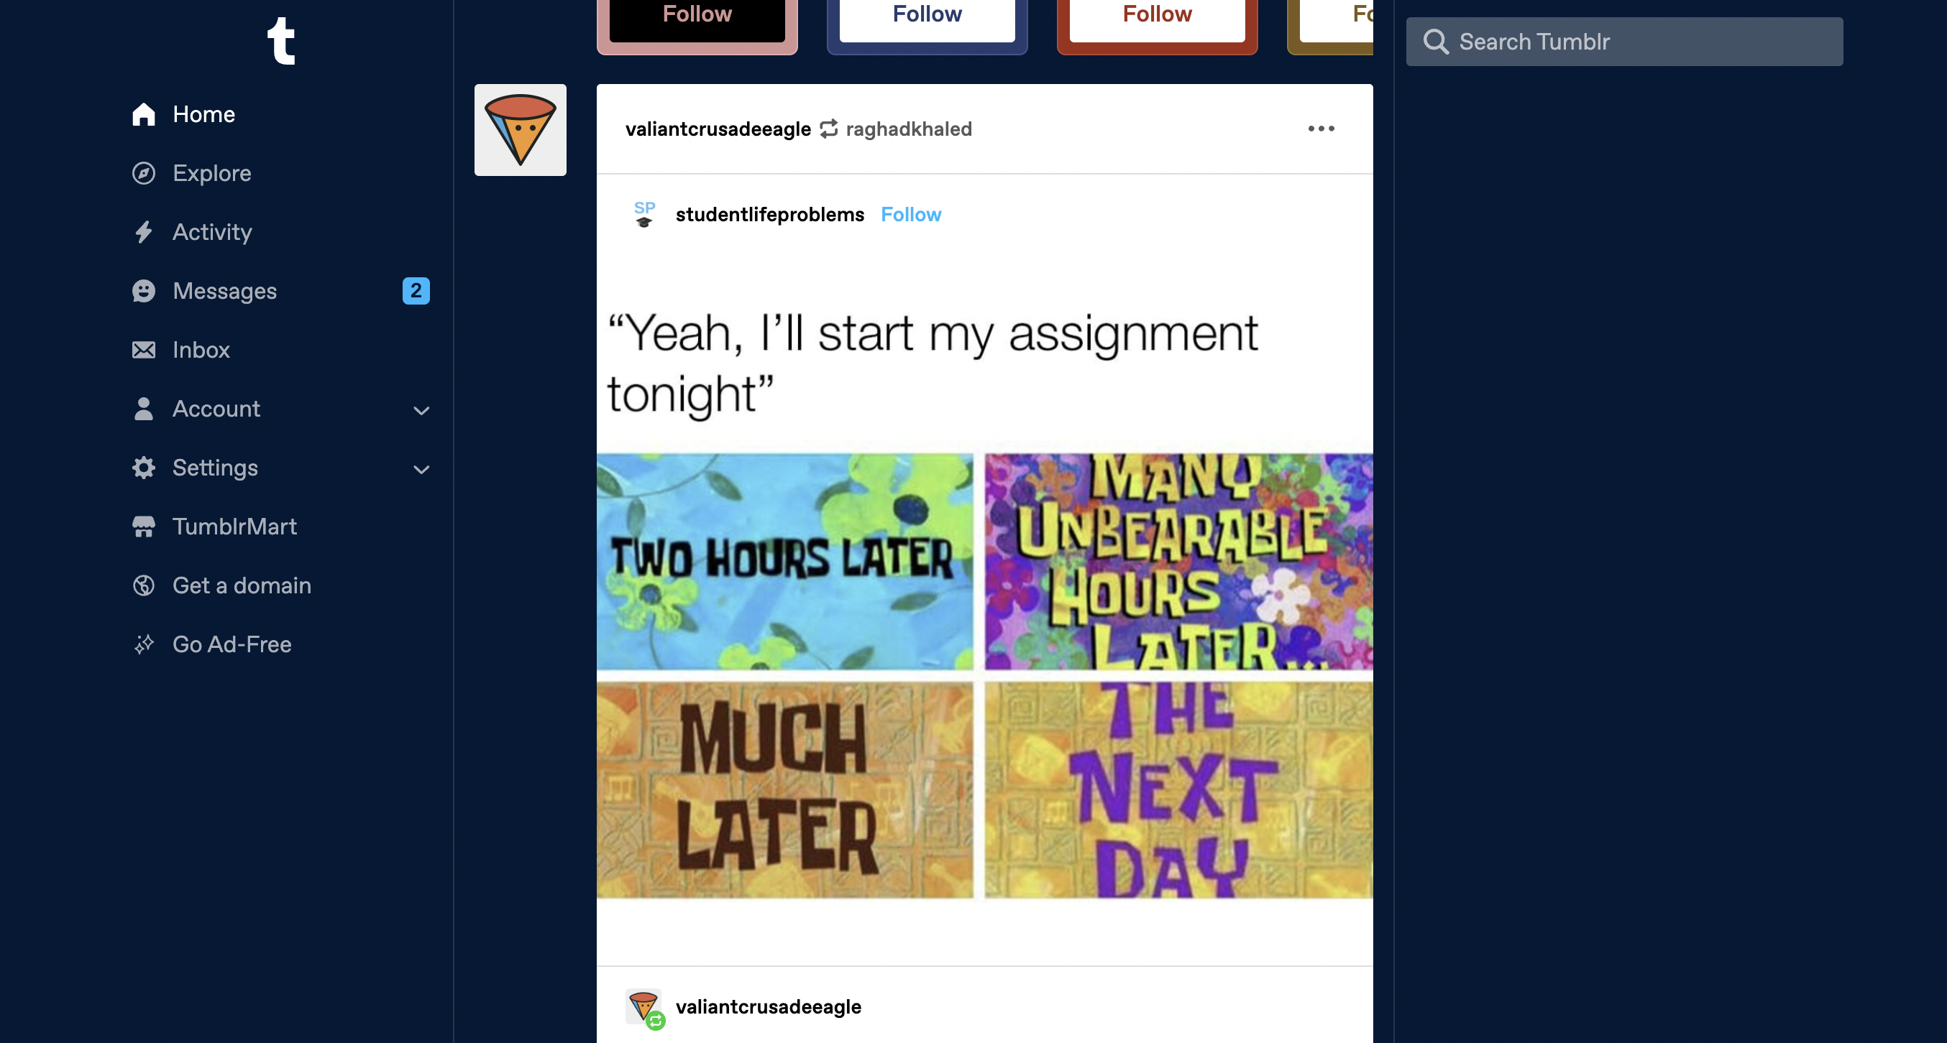
Web Programming Languages
In the most general form, also associated with a database (dynamic website)

Slide 28
So Far
Motivation
Steps to Build a Website
Web Programming Languages
How the Internet Works
Coding Setup
Basic HTML

Slide 29
Course Timeline
HTML
CSS
JavaScript
React
Node.js
MongoDB
Pure Front-end

Slide 30

Motivating HTML
Observation Any website corresponds to a finite set of elements
Such as headings, paragraphs, lists, links, buttons, images, video, audio, etc.
Nesting of HTML elements is also possible and helps styling
What are the elements you can recognize in this page?

Slide 31
Motivating HTML
Observation Any website corresponds to a finite set of elements
Such as headings, paragraphs, lists, links, buttons, images, video, audio, etc.
What are the elements you can recognize in this page?

Slide 32
HTML Basics
Any website element corresponds to an HTML tag
Generally takes the following form
<tagname attribute=value> element_content </tagname>
For example
<h1 align="center">Hello World</h1>
Some elements are “void” (do not take any content) and take the form of self-closing tag
For example
<img src=”./cat.jpg" alt="Cute Cat” />
HTML tags are not case-sensitive

Slide 33
Coding Setup
Download VSCode
Install the Live Server Extension and VSCode Browser
Make a folder for your website and some HTML files
Click ”Go Live” at the bottom
Put the Browser Side-by-side with VSCode
Write your HTML files

Slide 34
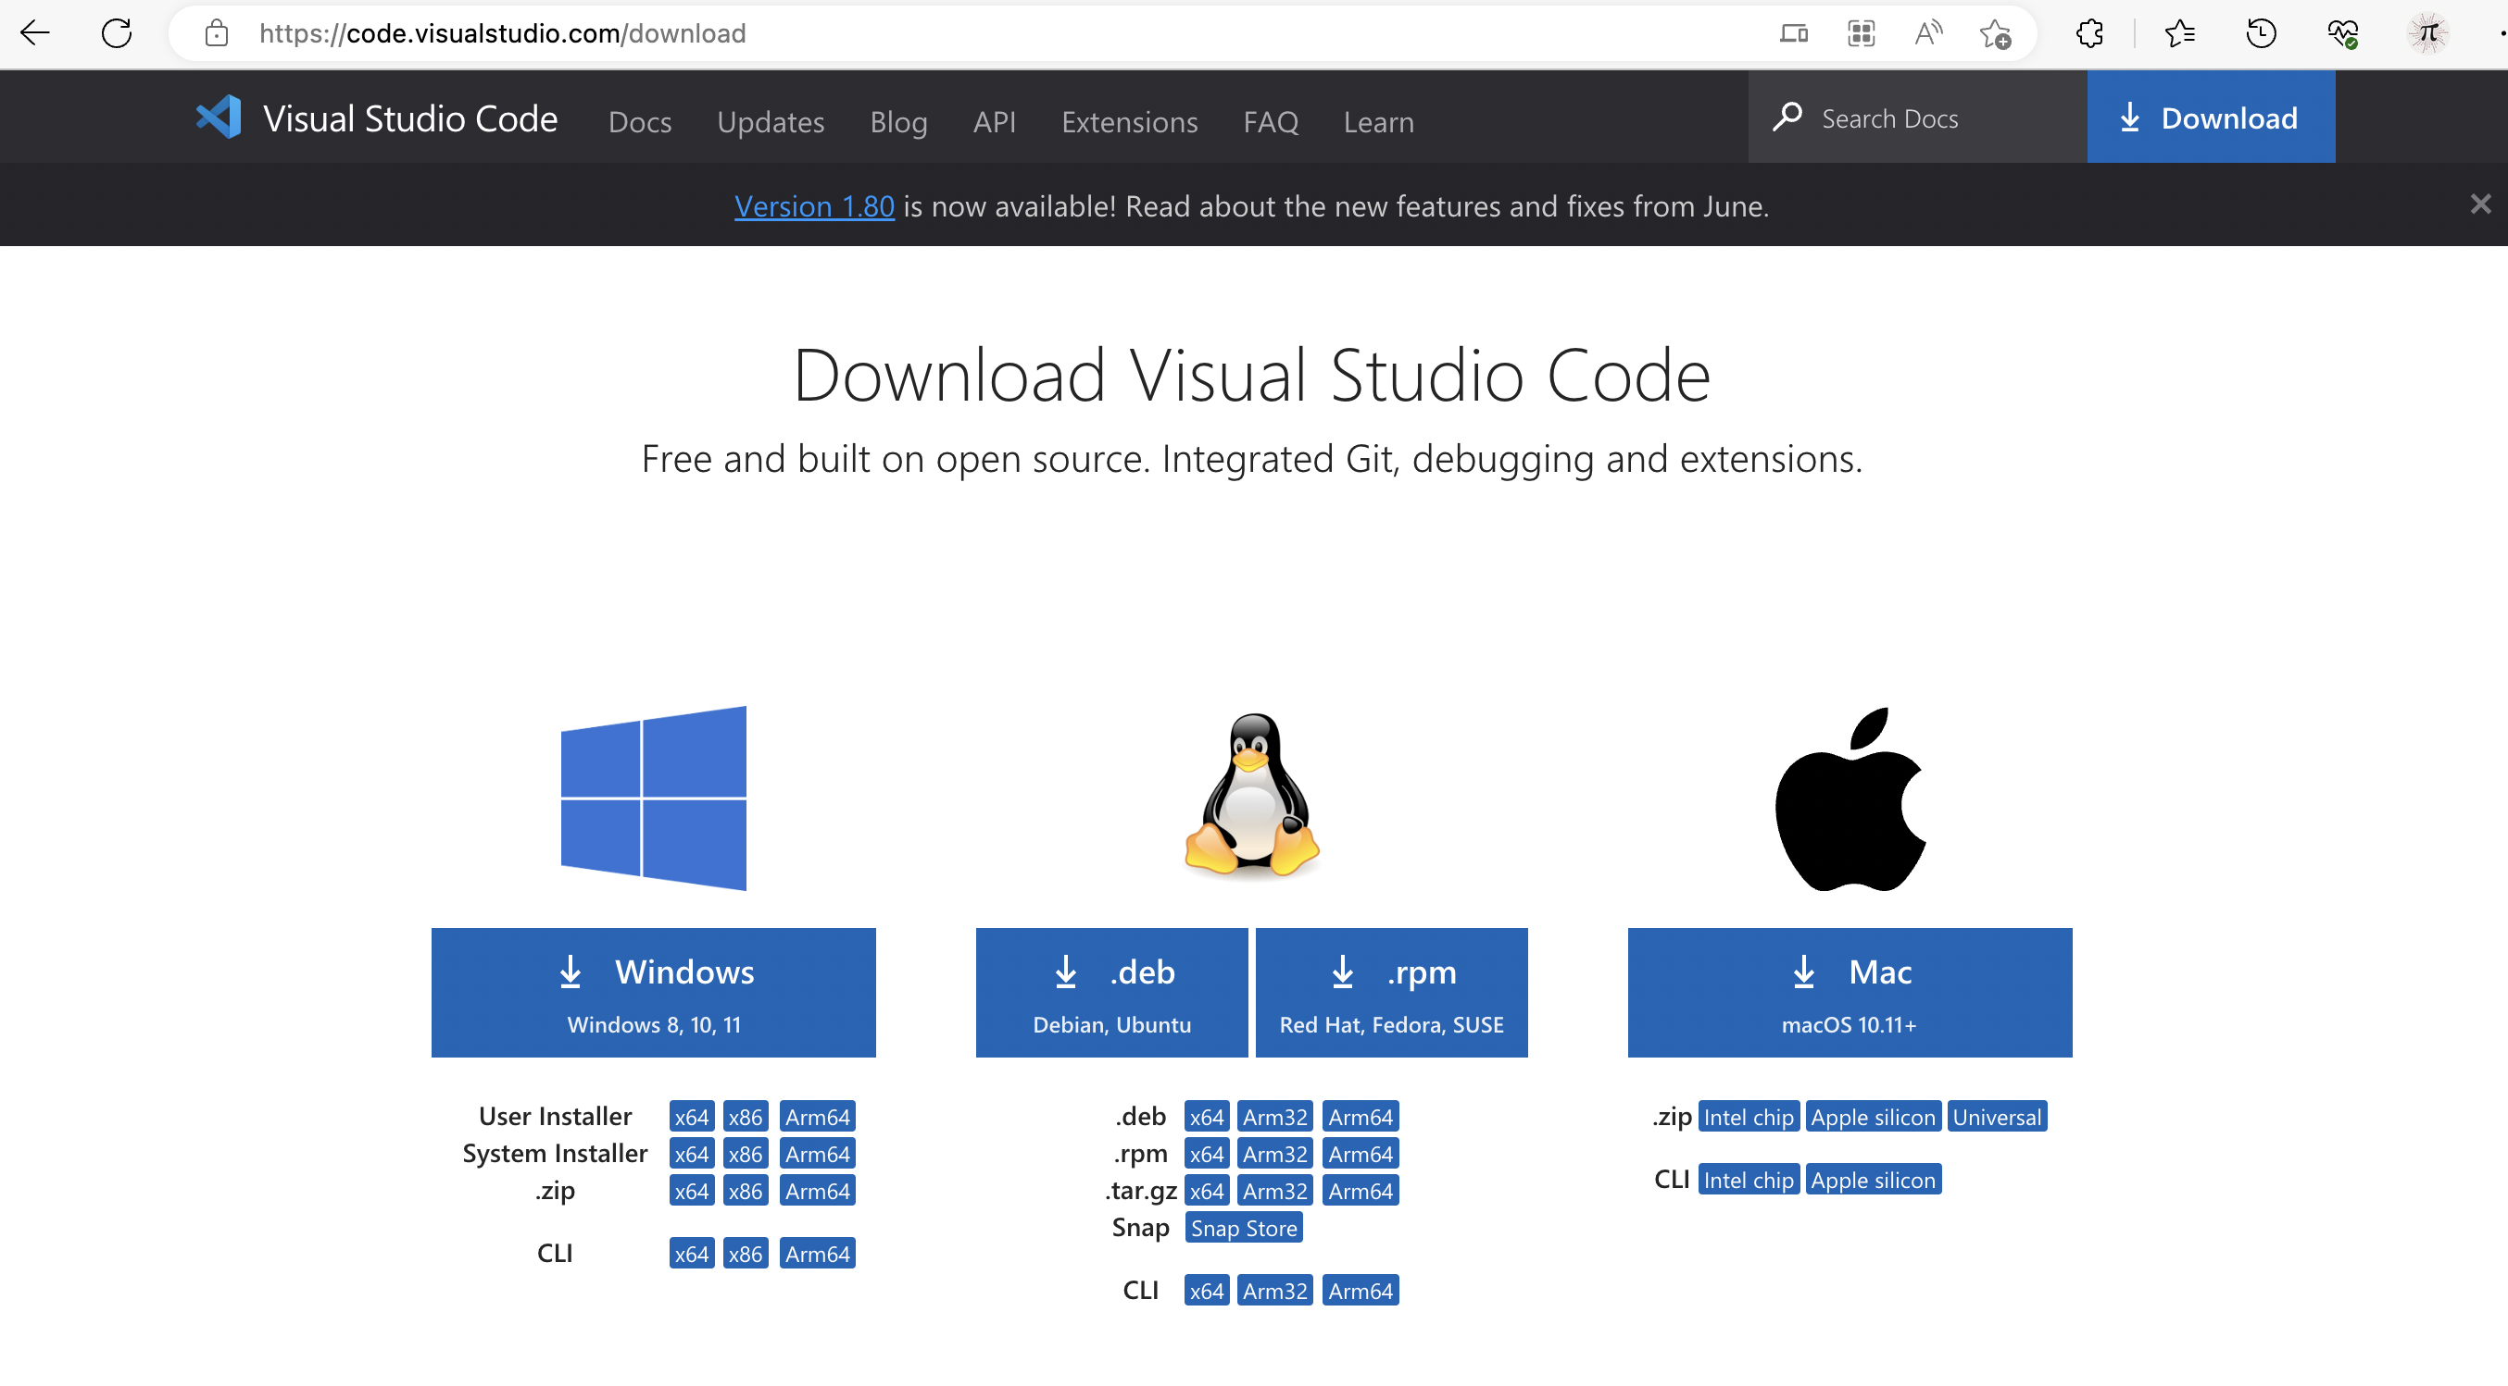
Download VSCode
Download VSCode
Install the Live Server Extension
Make a folder for your website and some HTML files
Click ”Go Live” at the bottom
Put the Browser Side-by-side with VSCode
Write your HTML files

Slide 35
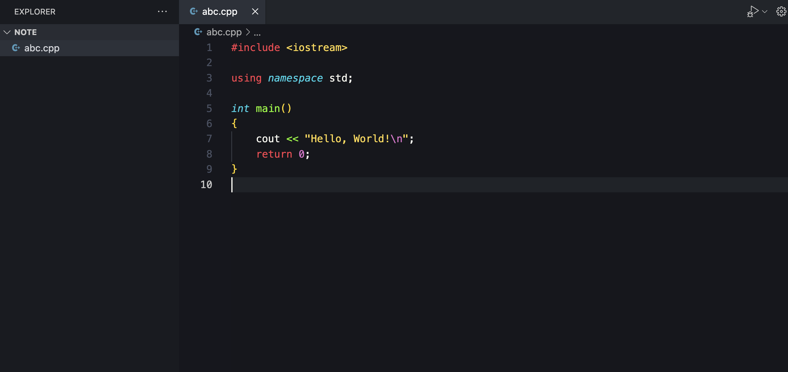
VSCode is just a Code Editor
Download VSCode
Install the Live Server Extension
Make a folder for your website and some HTML files
Click ”Go Live” at the bottom
Put the Browser Side-by-side with VSCode
Write your HTML files

Slide 36
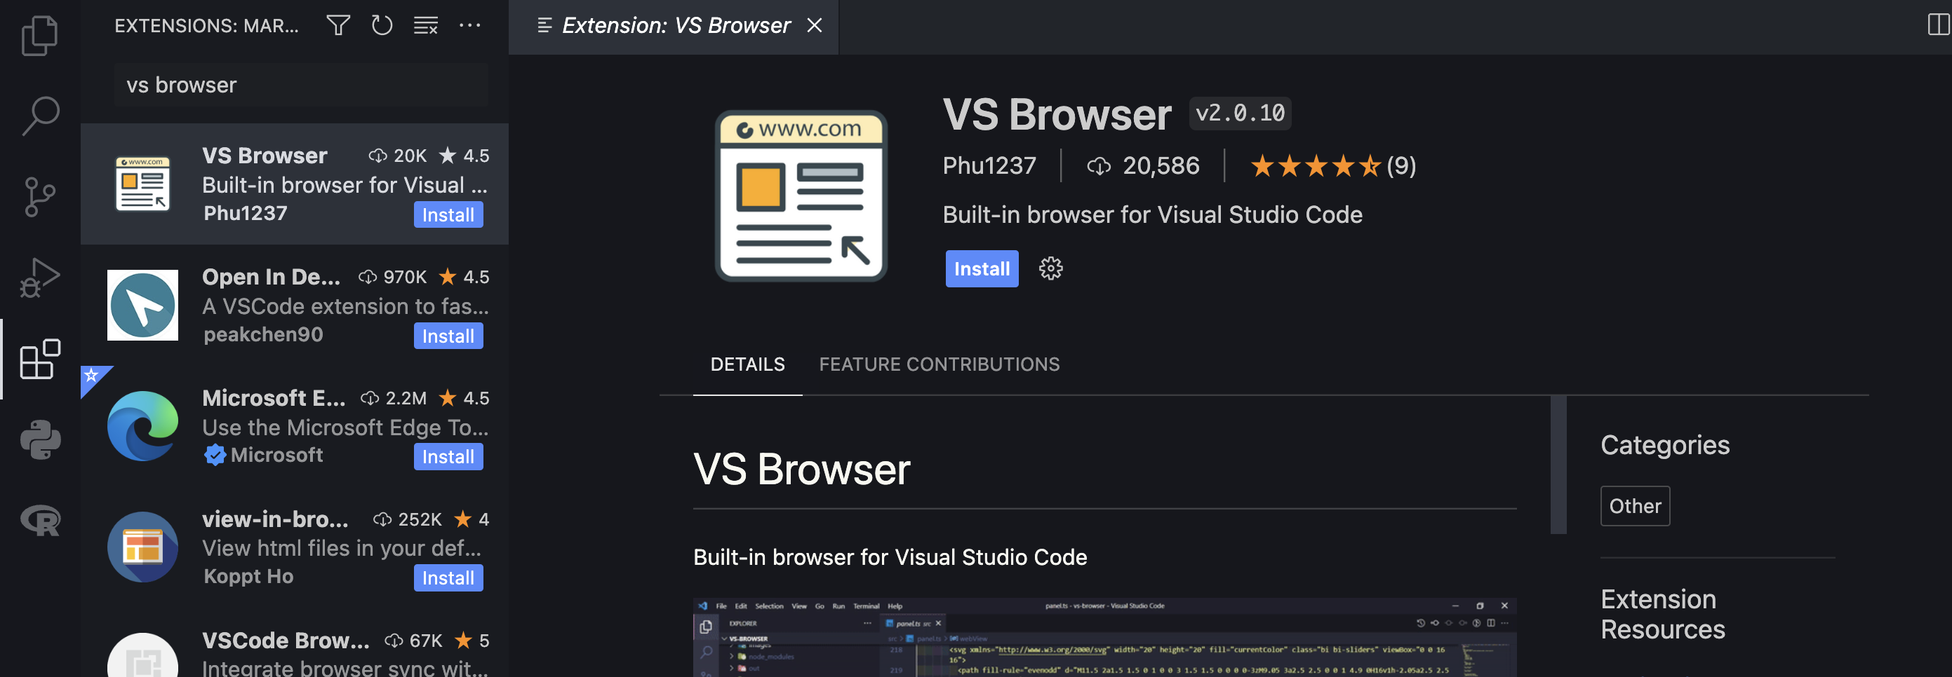
Install Live Server & Browser

Slide 37
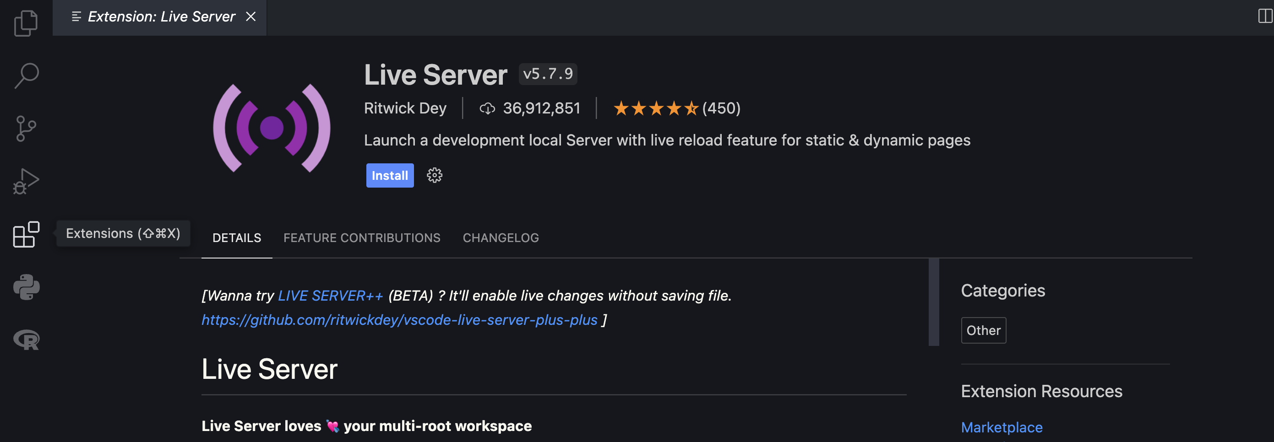
Install Live Server & Browser

Slide 38
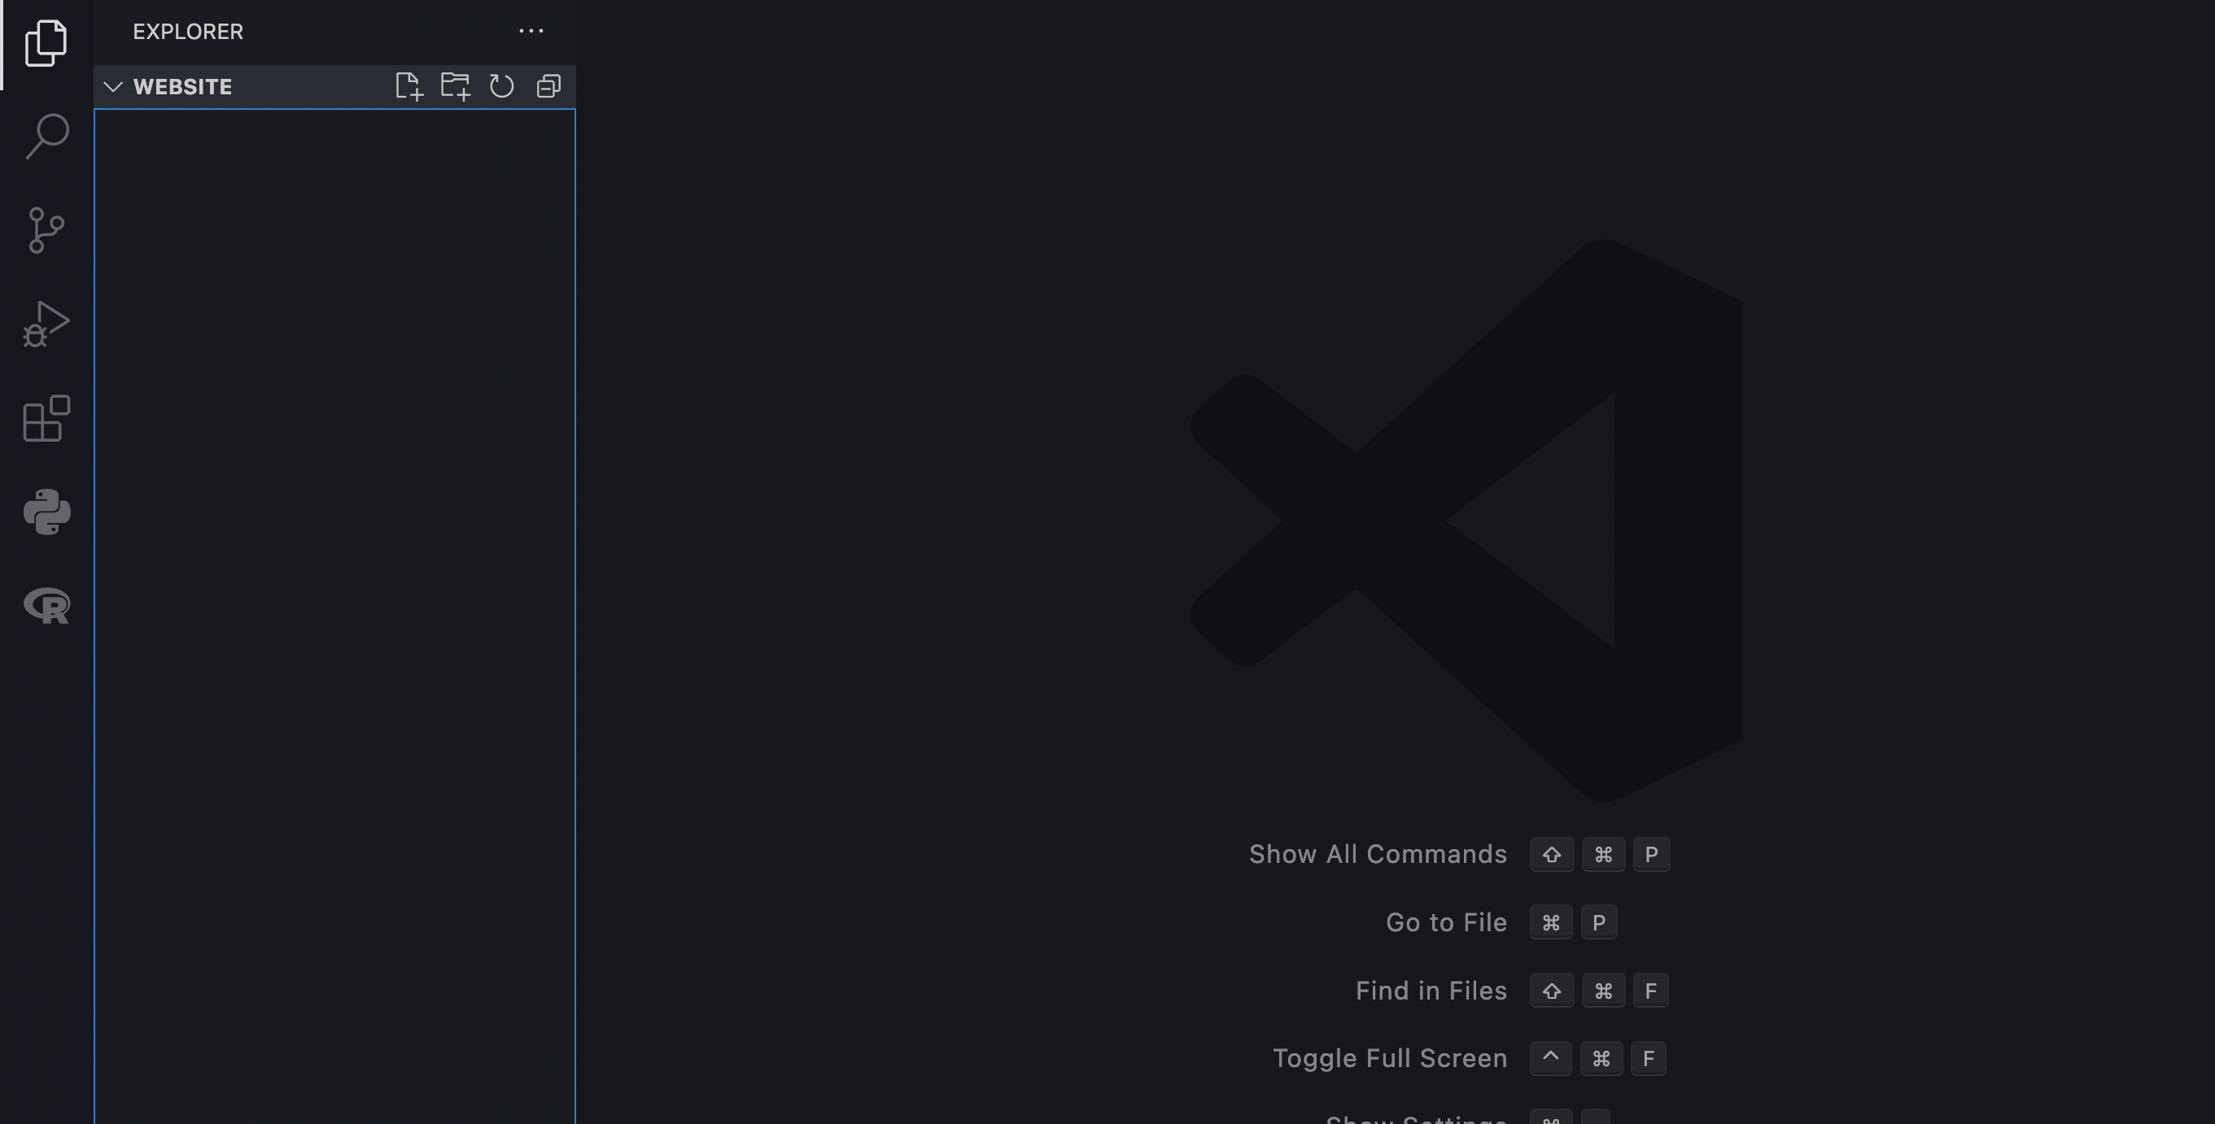
Make a Website Folder
CTRL+O then select the created folder

Slide 39
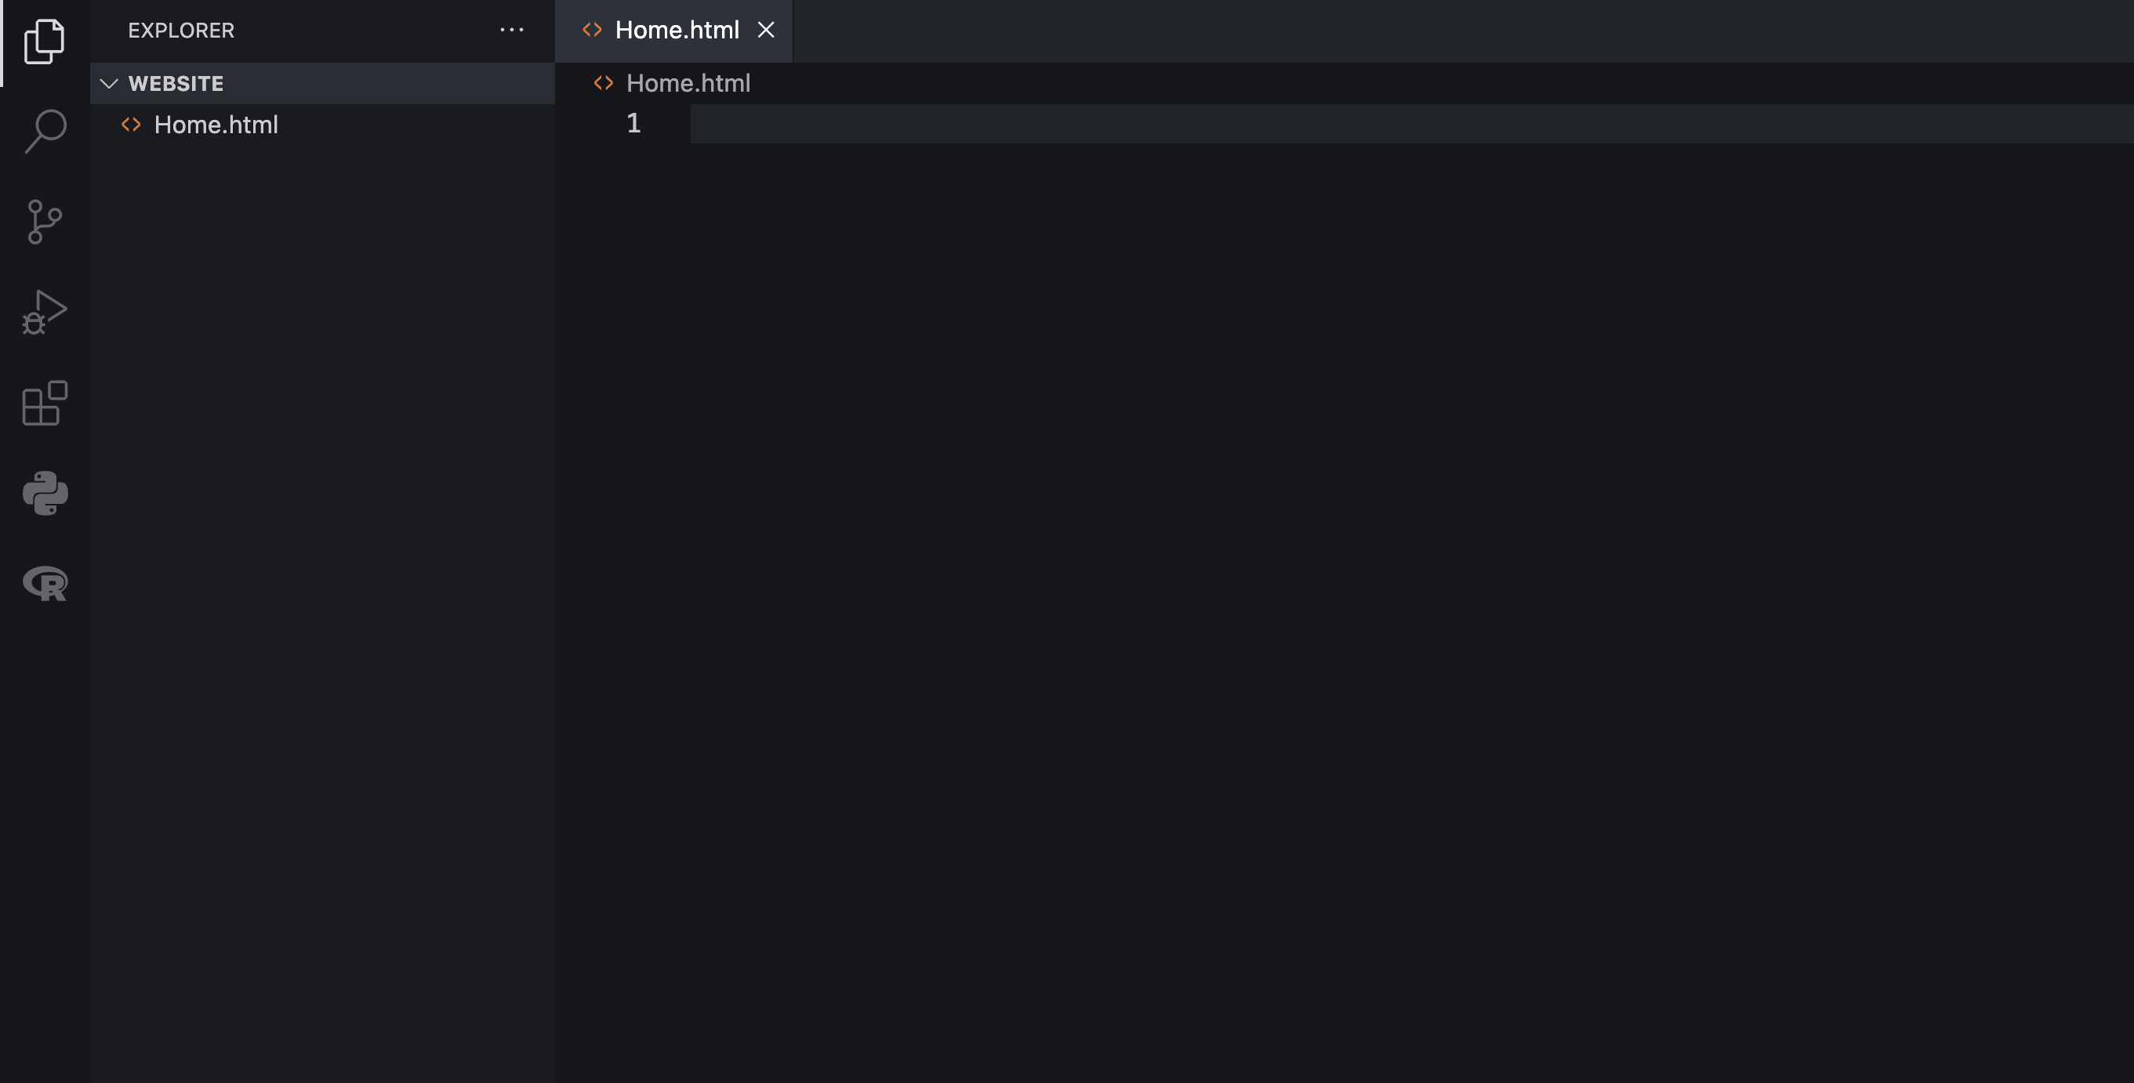
Make a Website Folder
2. Right-click in the EXPLORER area and create a new file “Home.html”

Slide 40
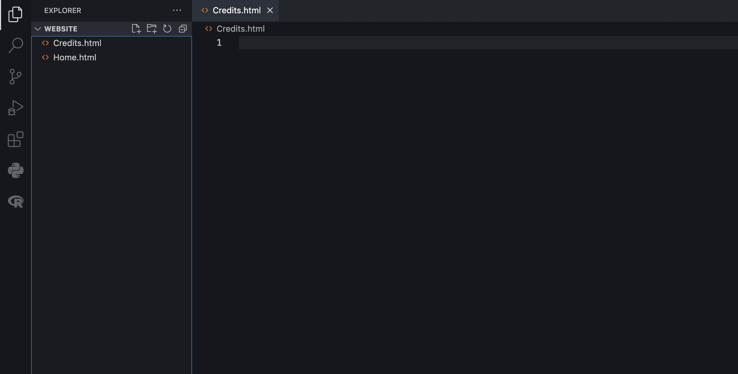
Make a Website Folder
3. Create more HTML files as needed for your website

Slide 41
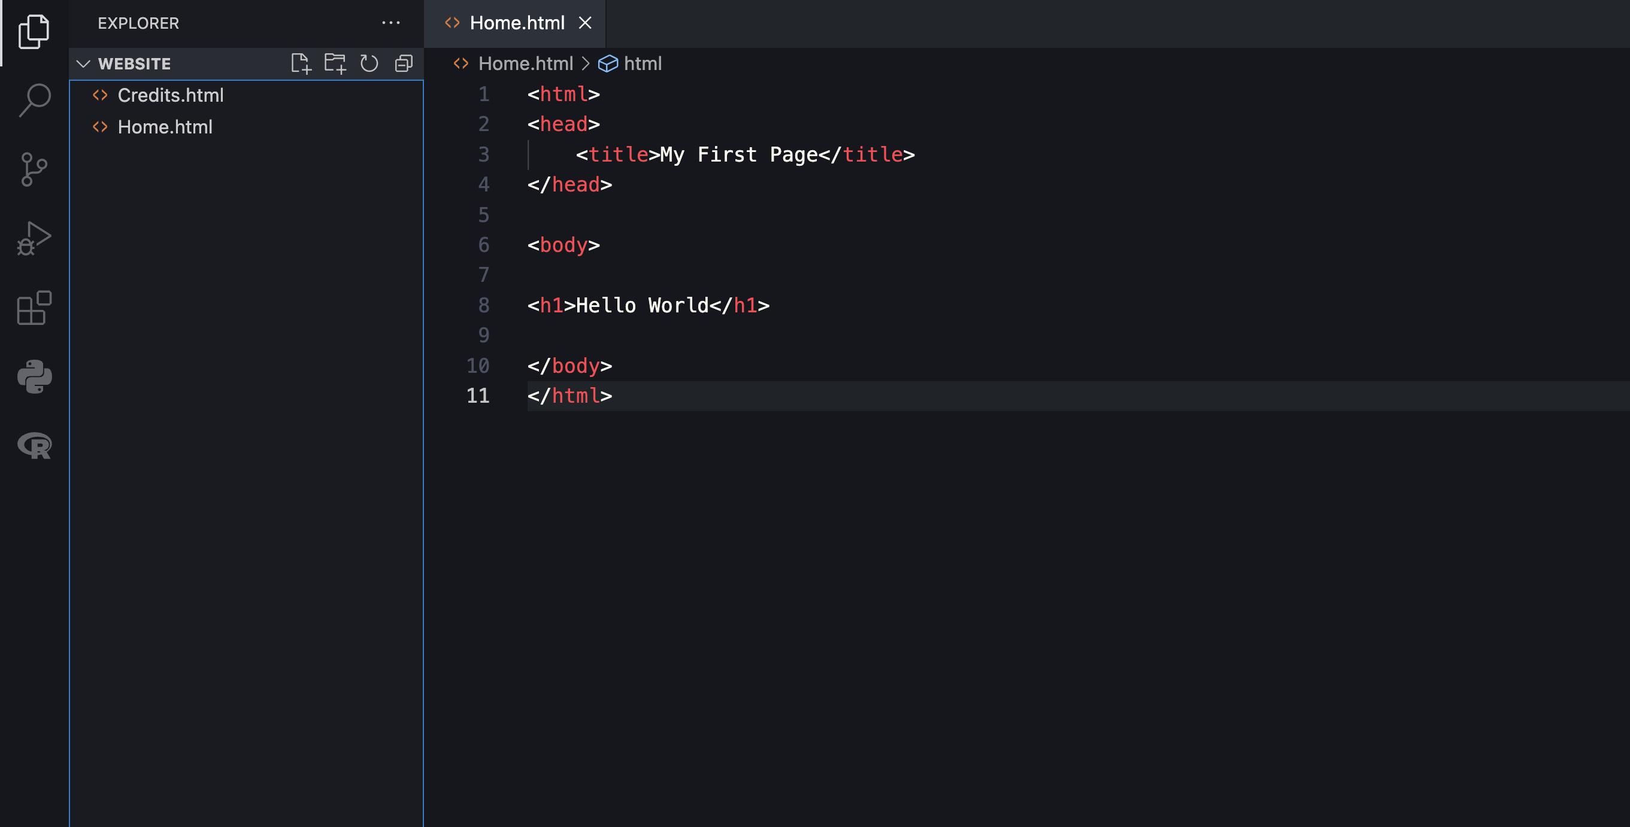
Make a Website Folder
4. Fill Content in HTML files

Slide 42
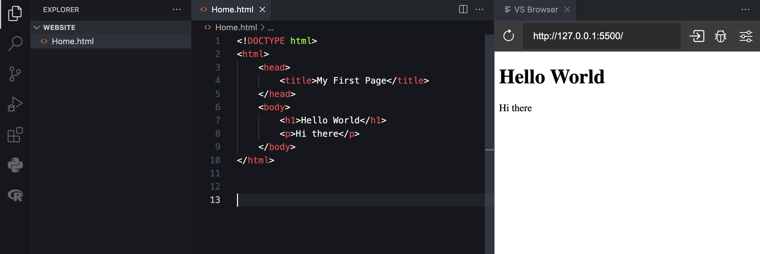
Make a Website Folder
5. Click ”Go Live” at the bottom and copy the link it opens
6. Click on VS Browser and paste the link there

Slide 43
Make a Website Folder
7. Now modifications to the code render in the browser at http://127.0.0.1:5500/Home.html
8. An index to all pages in the folder can be found in http://127.0.0.1:5500/

Slide 44
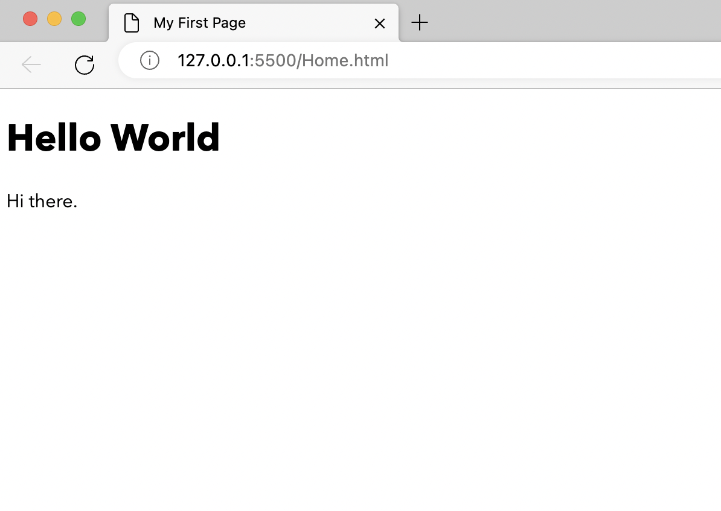
Hello World in HTML
<!DOCTYPE html>
<html lang="en">
<head>
<title>My First Page</title>
</head>
<body>
<h1>Hello World</h1>
<p>Hi there</p>
</body>
</html>

Slide 45
Hello World in HTML
Structure of any page is hence
<html>
<head>
<script>
<body>
Page Metadata
!DOCTYPE html
<style> or <link>
HTML for Page Content

Slide 46
HTML Head Tag
Generally,
<html>
<head>
<meta charset="UTF-8">
<meta name="keywords" content="Pets, Cats and Dogs">
<meta name="description" content="Free Kitties">
<title>A Meaningful Page Title</title>
<link rel="icon" type="image/x-icon" href=”imgur.com/abc">
<style>
...
</style>
<link rel="stylesheet" href="mystyle.css">
</head>
</html>

Slide 47
HTML CONTENT & STRUCTURE
<h1>content</h1>...<h6>content</h6>: Headings
<p>content</p>: Paragraph
<br/>: New Line
<hr/>: New Line
<div>HTML</div>: Wraps HTML for easier styling
<span>CONTENT</span>: Wraps text for easier styling

Slide 48
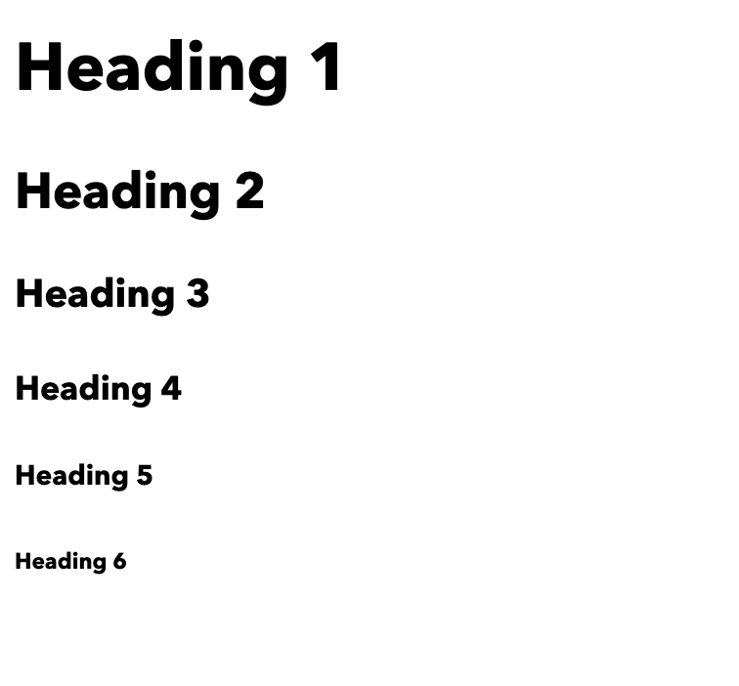
HTML Headings
<!DOCTYPE html>
<html>
<body>
<h1>Heading 1</h1>
<h2>Heading 2</h2>
<h3>Heading 3</h3>
<h4>Heading 4</h4>
<h5>Heading 5</h5>
<h6>Heading 6</h6>
</body>
</html>

Slide 49
Hello World in HTML
<!DOCTYPE html>
<html lang="en">
<head>
<title>My First Page</title>
</head>
<body>
<h1>Hello World</h1>
<p>Hi there</p>
</body>
</html>

Slide 50
Thank You

